Slide 1
Welcome to St Mary’s New Parents' Evening 2020

Slide 2
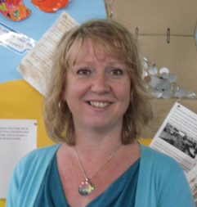
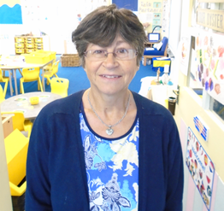
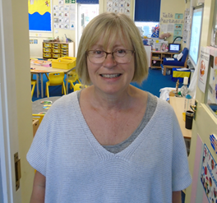
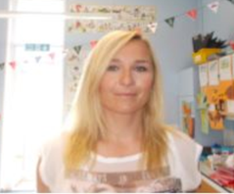
Reception Classes September 2020
Starfish Class
Shell Class
Miss Stevenson (Teacher)
Mrs Burtenshaw (Teaching Assistant)
Mrs Lauder (Teacher)
Mrs Thompson (Teaching Assistant)
Mrs Kanik
EAL Teaching Assistant (both classes)

Slide 3
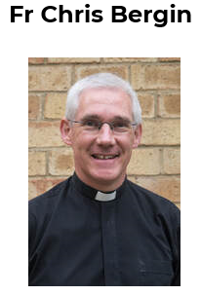
Our Lady of Sorrows Church
Fr Chris is our Parish Priest.
He has close links with the school and visits regularly. He welcomes us to Our Lady of Sorrows Church to learn about our faith.

Slide 4
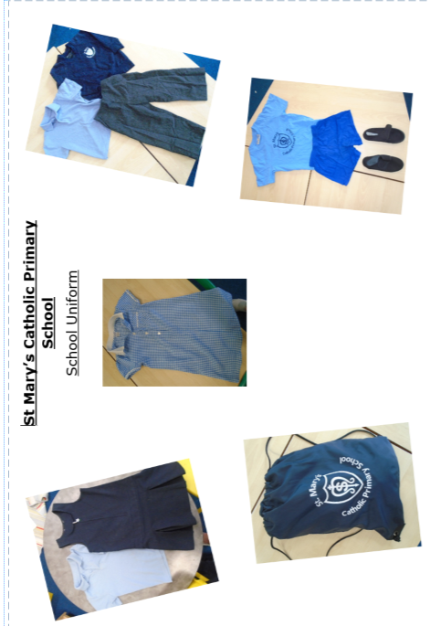
Uniform
Please label all clothing! Uniform without logos on can be bought anywhere. Uniform with logos can be purchased at JW Sports in Bognor. An extra pair of pants and socks are essential please to keep in the PE bag at school.

Slide 5
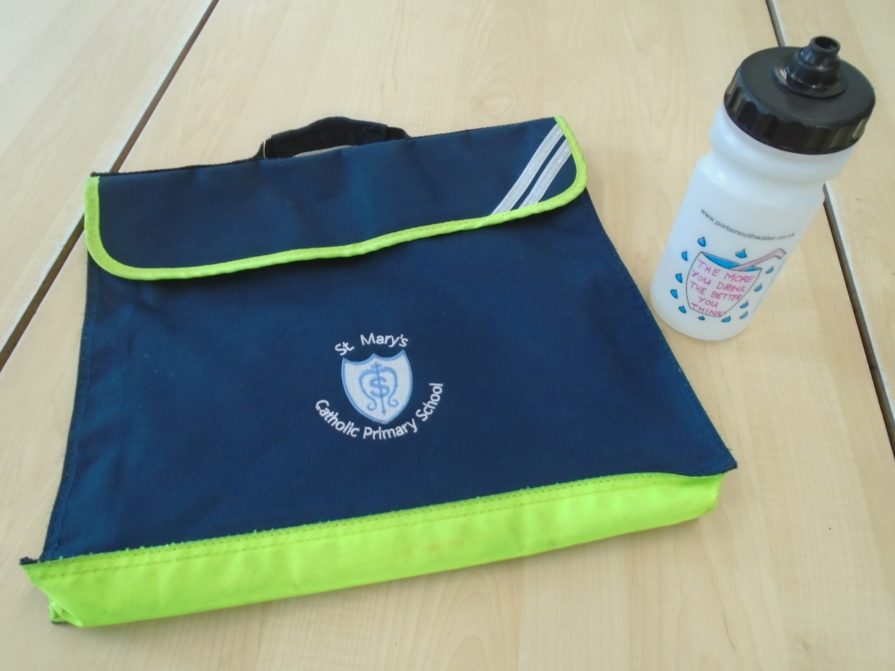
FSA Book bags and water bottles
These are kindly provided
by our Families and Staff Association.
We will give these to you on your first school visit.

Slide 6
Lunches and milk
Milk is free for under 5s but you must register on the coolmilk.com website. Children who are 5 or over need to pay. There is a letter about how to do this in your pack.
Your child can bring in a packed lunch or to have a meal provided by Chartwells. This is free.
Information is in your packs.

Slide 7
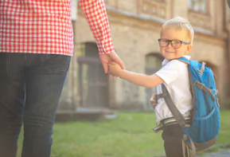
School visits
Because of this very unusual situation this year, we have not been able to visit the children in their pre-school setting or ask you to visit with the children.
Instead, we will be inviting you to come in for three short visits to the class between Thursday 3rd September and Friday 11th September 2020.
We will let you know your child's class by the end of the term.

Slide 8
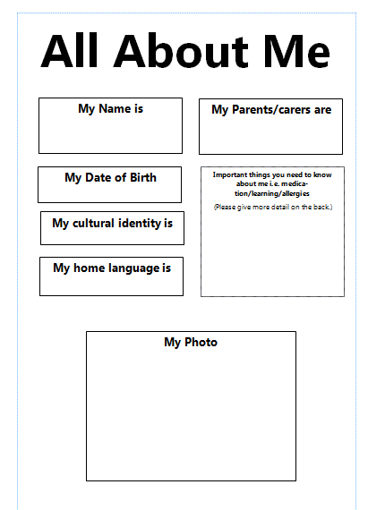
All About Me
Please complete at home over the summer (This will be sent to you nearer the end of term with details of the class your child will be in).
Please give to your child’s teacher on one of the school visits in September.

Slide 9
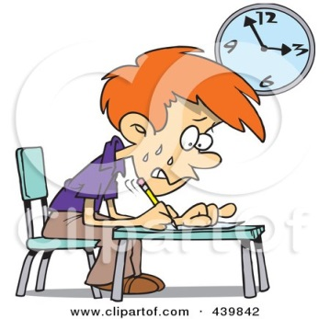
Staggered Start
Starting school is very tiring even
if your child is used to full-time nursery.
It can give a more gentle start to
the school environment
and school day.
It can help children to settle well
in the long run.

Slide 10
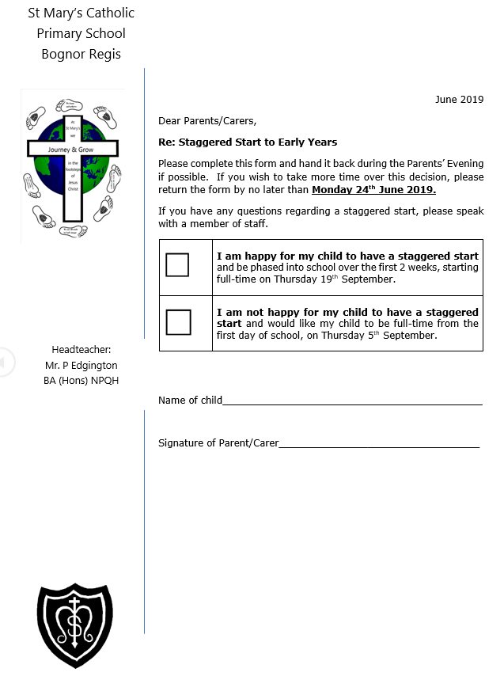
Staggered start form
We will give this out nearer the start date.
Please check in your pack for any letters with a particular return date.

Slide 11
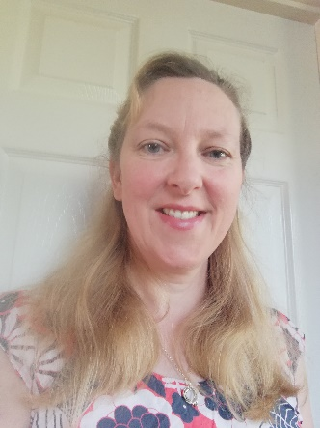
Mrs Lockwood Special Educational Needs and Disabilities Coordinator (SENDCO)
I have a few different roles in school but my main role is that of SENDCO. This means I oversee the provision for all of our pupils across the school that need extra help with their learning.
I work closely with the class teachers and teaching assistants to identify difficulties children may have and then work with the families to plan the best support for them. I also liaise with other agencies such as the Speech Therapy or Occupational Health Teams.
If your child has additional needs, please come and see me and we can talk through what support they may need in school. If you become worried about your child’s learning then please speak to their teacher first, but I am always happy to meet with parents too.
The best way to contact me is via the school office.

Slide 12
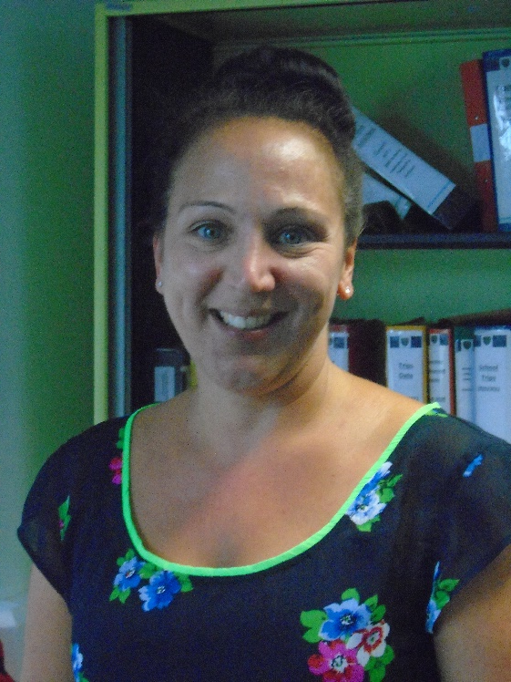
Further Support
Mrs Boniface is our Welfare and Attendance officer.
She takes care of any medical needs your child might have. If there are any medications, please take them to her in the Main Office.

Slide 13
Breakfast Buddies
This is a club provided by the team from Breakfast Buddies and runs from 7.30am until we start the school day.
It costs £5 per session with a discount if booked for the week.
It takes place in the Parish Hall and a variety of breakfast and activities are provided.

Slide 14
S.M.A.S.H (St. Mary’s After School Hub)
This normally runs after school in the Parish hall from 3pm-5pm on week days.
It is available to all children from Early Years to Year 6 and they provide snacks, games and a chance to play alongside other year groups.

Slide 15
Please watch the virtual tour of our school
If you have any questions, then type them into the chat option on your screen and we will answer them at the end.

