Slide 1
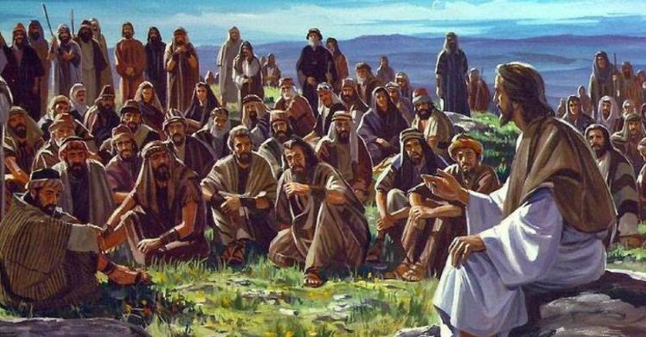
https://www.youtube.com/watch?v=5Pj2P8Bn5WI Close your eyes and listen to the music. What does worship mean? How can you show your commitment to God? What are you thankful for today?

Slide 2
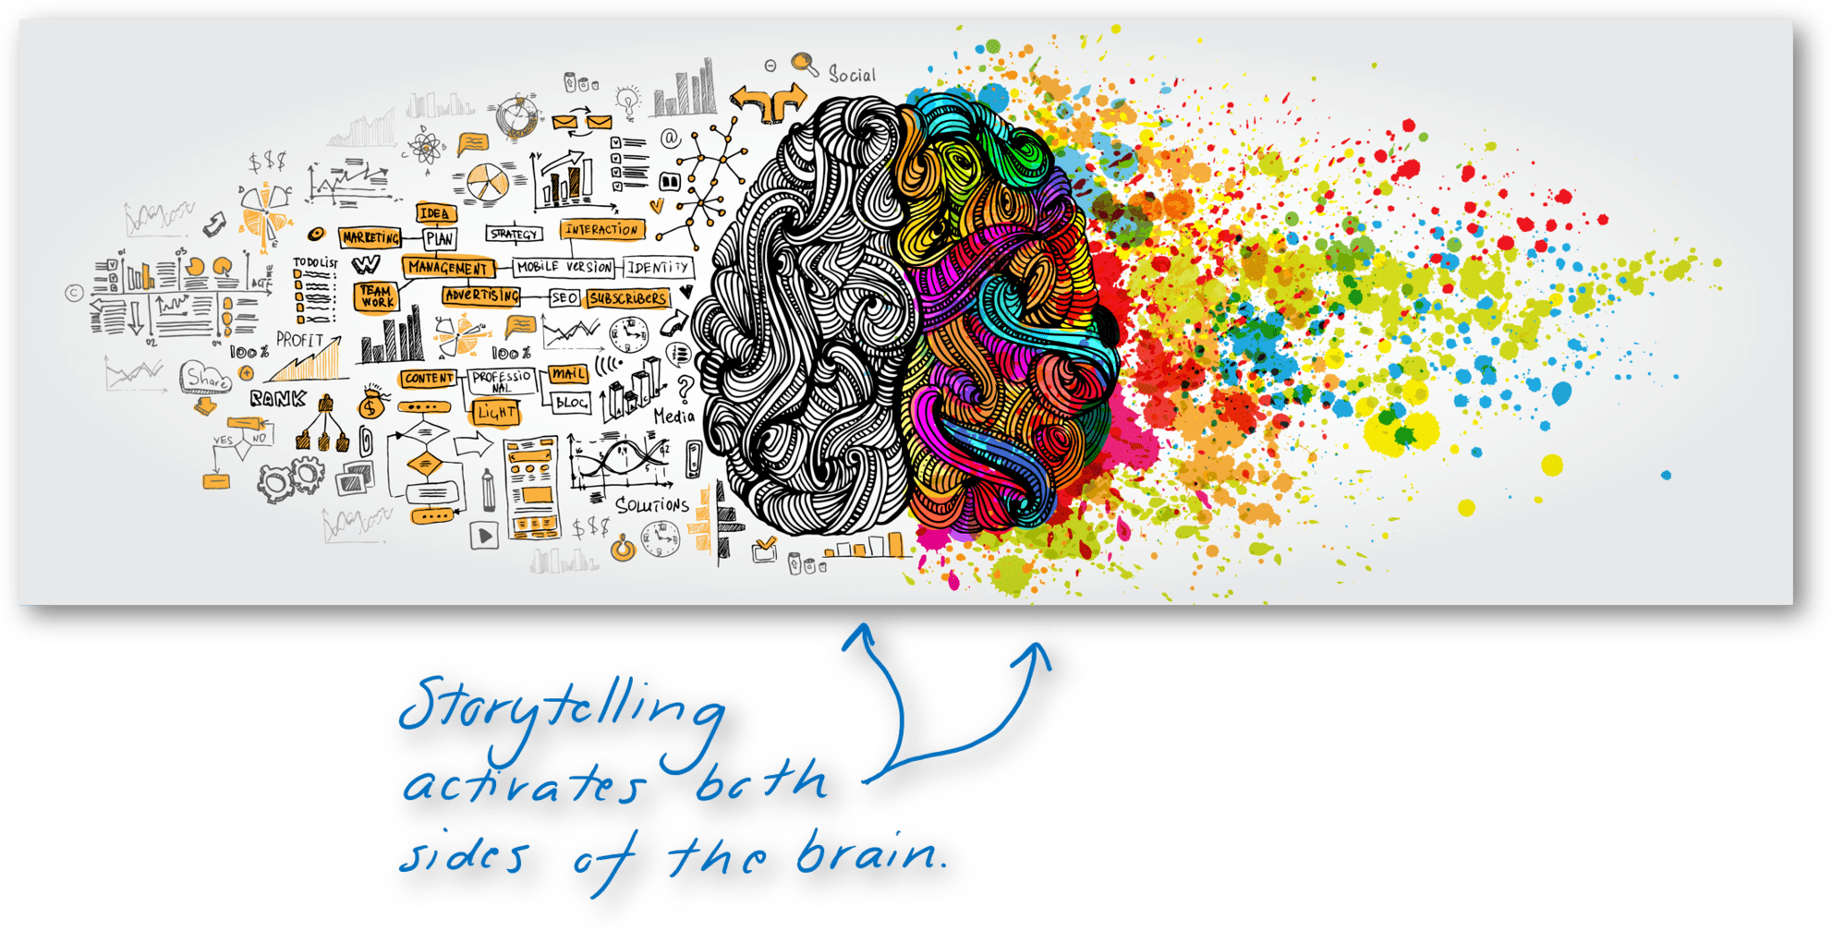
Storytelling is done all over the world and human beings are unique in having the skills and imagination to think up and communicate stories, which can be done in many ways!
Oral storytelling is an ancient art with common subjects which are included worldwide.
Stories can entertain, pass on old knowledge, create strong emotions, influence others, answer questions and explain mysteries. Within religious communities, stories can also be used to teach, pass on wisdom, reveal messages or truths and explore rules or codes for living.

Slide 3
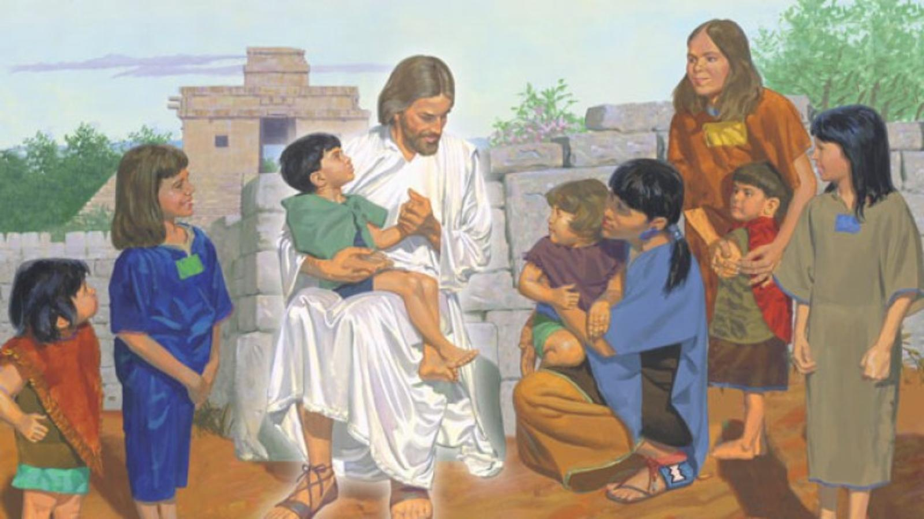
What is your favourite story from the bible that you have heard?
My favourite story is…
Why is this your favourite?
It is my favourite because…
What did it teach you?
It taught me that…

Slide 4
Task: Select one of the five topics below to create, develop, perform and produce an audio/video recording, a Lego story, a role play or a written version of a story which shows an understanding of their chosen topic in a religious way.
Forgiveness – e.g. where you forgive a friend for something they have done, even if it was on purpose.
Gratitude – e.g. where you repay some kindness that you received.
Loving/kindness – e.g. when a stranger does something for you.
Mercy – when you forgive someone even though you could punish them for what they have done.
Truth – when you told the truth even if it meant you got into trouble.

