Slide 1
The Baptism of Jesus
Mark 1: 7-11

Slide 2
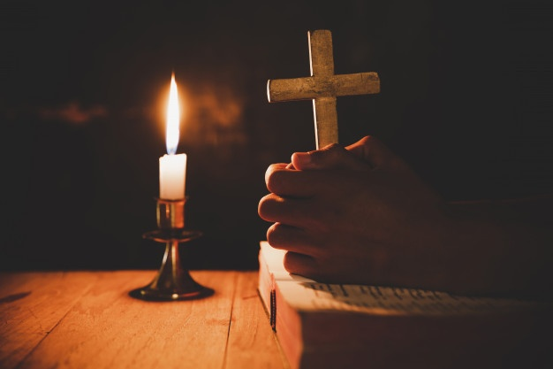
The Sign of the Cross

Slide 3
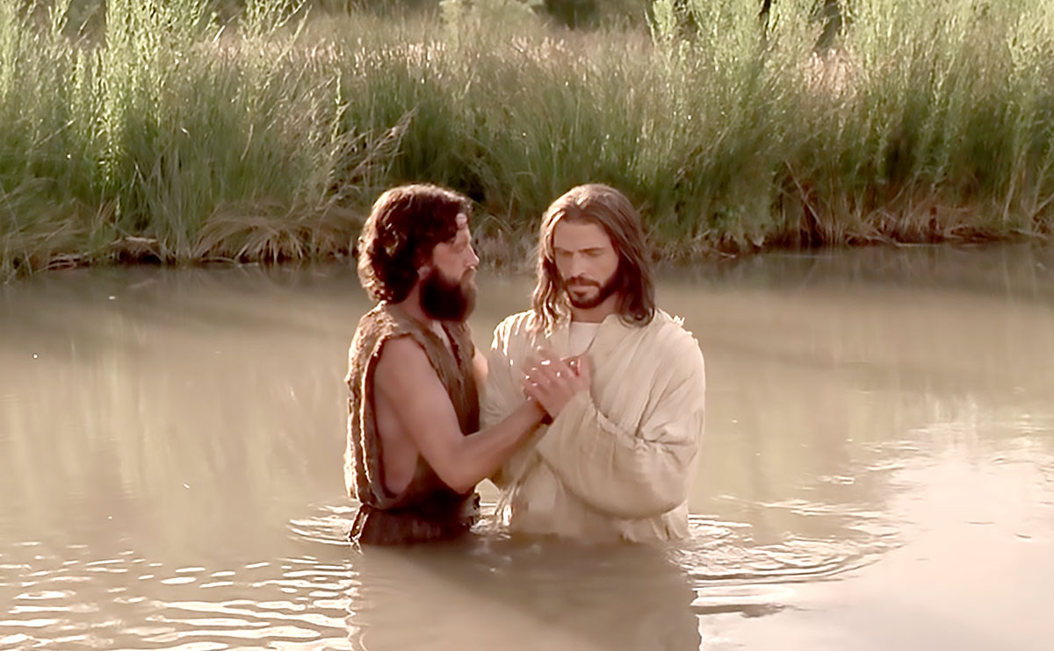
A reading from the Holy Gospel according to St Mark; Glory to You, Lord!

Slide 4
How much do you know about the Sacrament of Baptism?

Slide 5
1.Which liquid is used to baptise someone?
A | Wine
B | Water
C | Honey

Slide 6
2. In which river was Jesus baptised?
A | Nile
B | Amazon
C | Jordan

Slide 7
3. Who baptised Jesus?
A | John
B | Peter
C | Paul

Slide 8
4. What was heard when Jesus was baptised?
A | God’s voice
B | Thunder
C | Rushing wind

Slide 9
5. How did the Holy Spirit appear?
A | As holy fire
B | As a lion
C | As a dove

Slide 10
6. Which oils are used in baptism?
A | Catechumens and Chrism
B | Chrism and Oil of the Infirm
C | Catechumens and balsam

Slide 11
7. Who helps the baptised person?
A | Goodparents
B | Goldparents
C | Godparents

Slide 12
8. What is given to the baptised person?
A | A shell
B | A candle
C | Holy Water

Slide 13
The Beattitudes

Slide 14
A Prayer for Faith
Father God
Help us to remember the grace you gave us in Baptism.
Help us to be strong:
Standing up for what is right;
Telling the Truth;
Living in Your light.
In the Name of Jesus,
Amen.

